Slide 1
BIBS
MRM Deep Learning Analysis
최정인

Slide 2
INDEX
01 Summary of Peptides & Proteins
02 Marker Selection using SHAP value
03 Results compared to Oncotarget

Slide 3
01
Summary of Peptides & Proteins

Slide 4
MRM DL 분석
01. Summary of peptides & proteins
Peptide | Gene
GDIGETGVPGAEGPR | ADIPOQ
DPTFIPAPIQAK | AGT
QGIQFYTQLK | ALDH6A1
EFGNTLEDK | APOC1
EWFSETFQK | APOC1
VCPFAGILENGAVR | APOH
ILSGDPYCEK | BTD
LSSGLVTAALYGR | BTD
DYFIATCK | C1R
TNFDNDIALVR | C1S
TWYPEVPK | C4BPA
LSLEIEQLELQR | C4BPA
ALLAFQESK | C4BPB
NADYSYSVWK | C5
GGSASTWLTAFALR | C5
TLNICEVGTIR | C6
VLFYVDSEK | C7
EPAVLELEGK | CAP1
VLDVNDNAPK | CDH11
GEWVALNPLR | CFH
TGESVEFVCK | CFH
VFSLQWGEVK | CFI
TLLSNLEEAK | CLU
ASSIIDELFQDR | CLU
Peptide | Gene
GLPGEVLGAQPGPR | COL4A2
CDLISIPK | CORO1C
LSNNALSGLPQGVFGK | CPN2
VSTLPAITLK | CTSD
ELLALIQLER | ECM1
FAVLQENVAWGNGR | FCGBP
LSFQEFLK | FSTL1
ASCLYGQLPK | GSTP1
DGYLFQLLR | HRG
SPAYTLVWTR | HSPG2
LLGIETPLPK | ICAM1
VTLNGVPAQPLGPR | ICAM1
GLIDLTLDK | IFRD1
LIQGAPTIR | IGFBP2
ALAQCAPPPAVCAELVR | IGFBP3
YGQPLPGYTTK | IGFBP3
IQPSGGTNINEALLR | ITIH2
LALDNGGLAR | ITIH4
AGFSWIEVTFK | ITIH4
DSVTGTLPK | KLKB1
IVVVTAGVR | LDHB
GLTSVINQK | LDHB
DLLLPQPDLR | LRG1
VAAGAFQGLR | LRG1
Peptide | Gene
FQASVATPR | MBL2
ALAPEYAK | P4HB
GDSVSDSGSDALR | PDCD4
CDENILWLDYK | PKM2
NIQSLEVIGK | PPBP
ICLDPDAPR | PPBP
NNLELSTPLK | PROS1
DTEVLLVGLEPGTR | PTPRJ
CINQLLCK | SEPP1
GFQQLLQELNQPR | SERPINA5(IPSP)
VAEGTQVLELPFK | SERPINC1
IEDGFSLK | SERPINC1
FLEQECNVLPLK | SFTPB
VTGVVLFR | SOD3
NVLVTLYER | SPARC
GFLLLASLR | THBS1
TIVTTLQDSIR | THBS1
AADDTWEPFASGK | TTR
CMPTFQFFK | TXN
ILLAELEQLK | VIM
Unsuitable for kit
Suitable for kit but negatively correlated
Suitable for kit and
positively correlated
Sign of Correlation was determined by single logistic regression
Notes:
심리학에서 나온 자극-반응의 이론을 토대로,

Slide 5
MRM DL 분석
01. Summary of peptides & proteins
Peptide | Gene
GDIGETGVPGAEGPR | ADIPOQ
DPTFIPAPIQAK | AGT
ILSGDPYCEK | BTD
LSSGLVTAALYGR | BTD
DYFIATCK | C1R
TNFDNDIALVR | C1S
TWYPEVPK | C4BPA
LSLEIEQLELQR | C4BPA
ALLAFQESK | C4BPB
NADYSYSVWK | C5
GGSASTWLTAFALR | C5
TLNICEVGTIR | C6
VLFYVDSEK | C7
VLDVNDNAPK | CDH11
GEWVALNPLR | CFH
TGESVEFVCK | CFH
VFSLQWGEVK | CFI
Peptide | Gene
LSNNALSGLPQGVFGK | CPN2
VSTLPAITLK | CTSD
LSFQEFLK | FSTL1
SPAYTLVWTR | HSPG2
LLGIETPLPK | ICAM1
VTLNGVPAQPLGPR | ICAM1
GLIDLTLDK | IFRD1
LIQGAPTIR | IGFBP2
LALDNGGLAR | ITIH4
AGFSWIEVTFK | ITIH4
DLLLPQPDLR | LRG1
VAAGAFQGLR | LRG1
Peptide | Gene
FQASVATPR | MBL2
ALAPEYAK | P4HB
NIQSLEVIGK | PPBP
ICLDPDAPR | PPBP
NNLELSTPLK | PROS1
FLEQECNVLPLK | SFTPB
VTGVVLFR | SOD3
NVLVTLYER | SPARC
GFLLLASLR | THBS1
TIVTTLQDSIR | THBS1
CMPTFQFFK | TXN
ILLAELEQLK | VIM
Unsuitable for kit
Suitable for kit but negatively correlated
Suitable for kit and
positively correlated
Sign of Correlation was determined by single logistic regression
41 Peptides and 32 Proteins
Notes:
심리학에서 나온 자극-반응의 이론을 토대로,

Slide 6
02
Marker Selection
Using SHAP Value

Slide 7
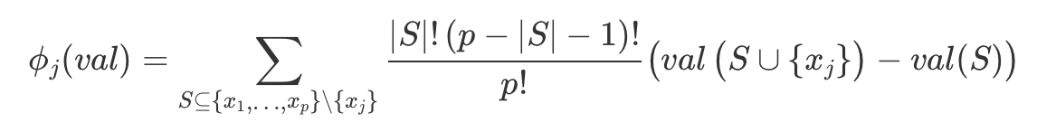
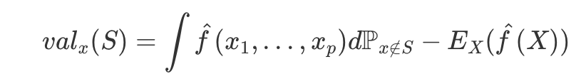
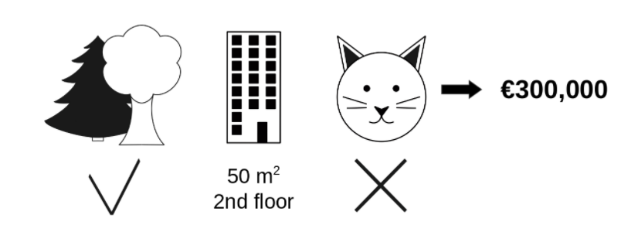
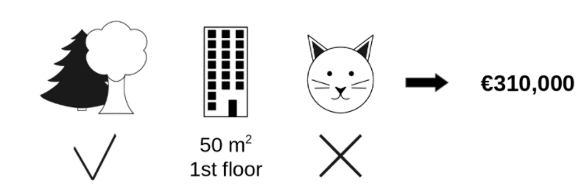
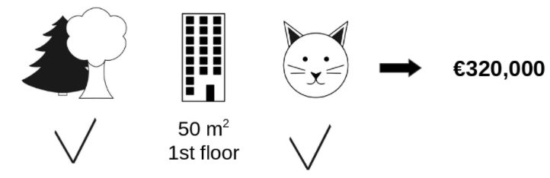
MRM DL 분석
02. Marker Selection Using DNN
Shapley Values
prediction for feature values in set S
that are marginalized over features
Notes:
valx(S) is the prediction for feature values in set S that are marginalized over features that are not included in set S:

Slide 8
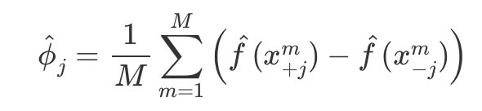
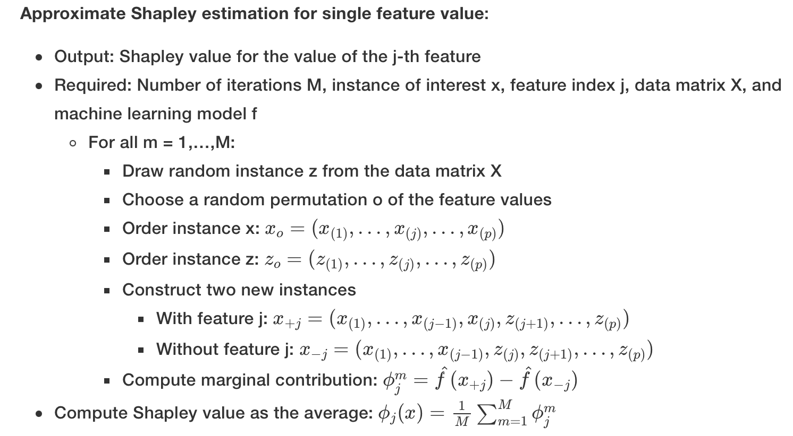
MRM DL 분석
02. Marker Selection Using DNN
Estimation of the Shapley Value
Strumbelj et al. (2014) propose an approximation with Monte-Carlo sampling:
Notes:
valx(S) is the prediction for feature values in set S that are marginalized over features that are not included in set S:

Slide 9

MRM DL 분석
02. Marker Selection Using DNN
SHAP(Shapley Additive Explanations) values
“Features with large absolute Shapley values are important! ”
각 데이터에 대해 Shapley value를 구할 수 있고,
이 n=1006개의 Shapley value의 절댓값의 합이 SHAP value이다.
Notes:
심리학에서 나온 자극-반응의 이론을 토대로,

Slide 10

MRM DL 분석
02. Marker Selection Using DNN
Feature Selection Using DNN
Peptide
Protein
Hidden Layer
Group
nn.Linear
+ ReLu
nn.Linear
+ ReLu
Sigmoid
각 Protein의 SHAP value가 클수록 더 중요한 Protein
Notes:
심리학에서 나온 자극-반응의 이론을 토대로,

Slide 11
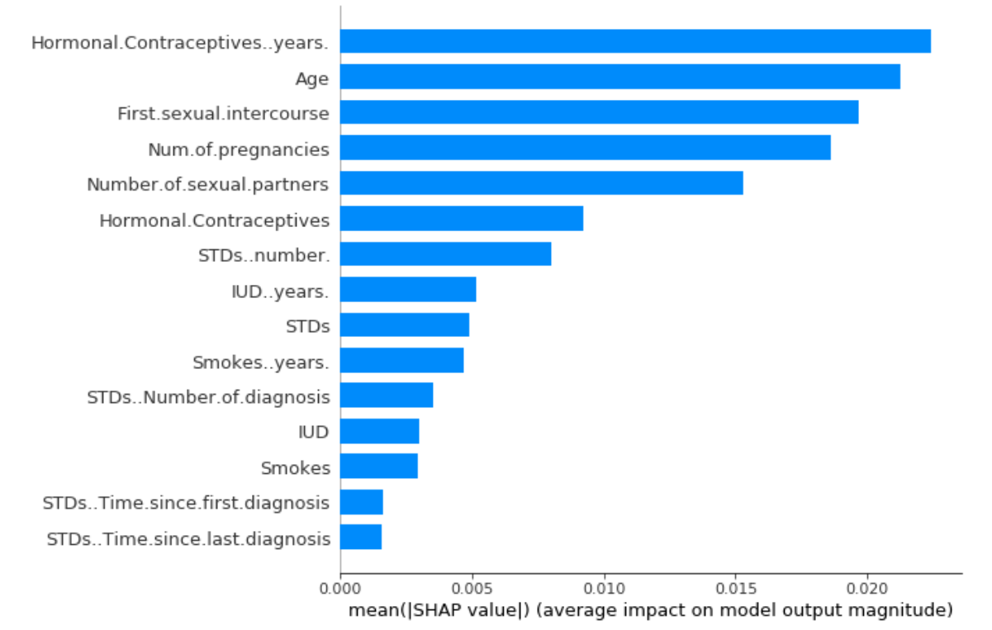
MRM DL 분석
02. Marker Selection Using SHAP value
Peptide | Gene
 | CA19-9
VLFYVDSEK | C7
VFSLQWGEVK | CFI
LSNNALSGLPQGVFGK | CPN2
SPAYTLVWTR | HSPG2
LIQGAPTIR | IGFBP2
NADYSYSVWK | C5
GGSASTWLTAFALR | C5
FQASVATPR | MBL2
GFLLLASLR | THBS1
TIVTTLQDSIR | THBS1
CMPTFQFFK | TXN
ILLAELEQLK | VIM
GLIDLTLDK | IFRD1
VTGVVLFR | SOD3
NVLVTLYER | SPARC
GLIDLTLDK | IFRD1
“shap” Python package
Top 15 Gene Selected
& mean(|SHAP value|)
Notes:
심리학에서 나온 자극-반응의 이론을 토대로,

Slide 12
03
Results compared to Oncotarget

Slide 13
MRM DL 분석
03. Results Compared to Oncotarget
Model | AUC_train | 10-CV AUC | AUC_test1 | AUC_test2 | AUC_test3 | AUC_test4
CA19_9 + LRG1 + TTR | 0.8994 | 0.8976 | 0.8929 | 0.8793 | 0.9024 | 0.6941
CA19_9 + C7 + CFI | 0.988 | 0.953 | 0.926 | 0.931 | 0.982 | 0.823
CA19_9 + IGFB2 + HSPG2 | 0.969 | 0.949 | 0.894 | 0.881 | 0.924 | 0.731
CA19_9 + CFI + C5 | 0.972 | 0.972 | 0.976 | 0.923 | 0.93 | 0.692
CA19_9 + C7 + C5 | 0.97 | 0.952 | 0.893 | 0.876 | 0.902 | 0.729
CA19_9 + C7 + IGFB2 | 0.969 | 0.944 | 0.892 | 0.871 | 0.914 | 0.736
CA19_9 + HSPG2 + MBL2 | 0.959 | 0.931 | 0.902 | 0.864 | 0.904 | 0.693
CA19_9 + C7 + THBS1 | 0.967 | 0.930 | 0.872 | 0.861 | 0.934 | 0.732
CA19_9 + VIM+ HSPG2 | 0.971 | 0.929 | 0.886 | 0.892 | 0.894 | 0.733
CA19_9 + IGFB2 + CFI | 0.969 | 0.915 | 0.901 | 0.853 | 0.884 | 0.683
CA19_9 + MBL2 + CFI | 0.956 | 0.914 | 0.897 | 0.849 | 0.874 | 0.648
Oncotarget: CA19_9 + LRG1 + TTR ; SVM
15C3의 경우의 수 중 10-fold CV AUC가 큰 순으로 Top 10개의 tripple marker 조합 선정
Positively correlated된 peptide만 사용한 결과 중 논문보다 좋은 triple-panel 2개 존재
Notes:
심리학에서 나온 자극-반응의 이론을 토대로,

Slide 14
MRM DL 분석
03. Results Compared to Oncotarget
Model | AUC_train | 10-CV AUC | AUC_test1 | AUC_test2 | AUC_test3 | AUC_test4
CA19_9 + LRG1 + TTR | 0.8994 | 0.8976 | 0.8929 | 0.8793 | 0.9024 | 0.6941
CA19_9 + IGFB2 + HSPG2 + THBS1 | 0.990 | 0.963 | 0.925 | 0.893 | 0.982 | 0.799
CA19_9 + IGFB2 + VIM + CFI | 0.989 | 0.962 | 0.939 | 0.929 | 0.994 | 0.814
CA19_9 + IGFB2 + C7 + CFI | 0.990 | 0.958 | 0.901 | 0.911 | 0.929 | 0.890
CA19_9 + C7 + C5 + THBS1 | 0.987 | 0.949 | 0.942 | 0.901 | 0.931 | 0.703
CA19_9 + C7 + IGFB2 + THBS1 | 0.986 | 0.932 | 0.899 | 0.878 | 0.902 | 0.789
CA19_9 + HSPG2 + MBL2 + VIM | 0.991 | 0.924 | 0.894 | 0.869 | 0.924 | 0.732
CA19_9 + C7 + THBS1 + HSPG2 | 0.972 | 0.923 | 0.891 | 0.874 | 0.931 | 0.713
CA19_9 + C5 + VIM + HSPG2 | 0.992 | 0.920 | 0.888 | 0.903 | 0.941 | 0.692
CA19_9 + IGFB2 + CFI + VIM | 0.984 | 0.919 | 0.871 | 0.921 | 0.892 | 0.683
CA19_9 + MBL2 + CFI + VIM | 0.938 | 0.910 | 0.903 | 0.897 | 0.843 | 0.679
Oncotarget: CA19_9 + LRG1 + TTR ; SVM
15C4의 경우의 수 중 10-fold CV AUC 가 큰 순으로 Top 10개의 4개 marker 조합 선정
Positively correlated된 peptide만 사용한 결과 중 논문보다 좋은 triple-panel 4개 존재
Notes:
심리학에서 나온 자극-반응의 이론을 토대로,

Slide 15
MRM DL 분석
03. Results Compared to Oncotarget
Model | AUC_train | 10-CV AUC | AUC_test1 | AUC_test2 | AUC_test3 | AUC_test4
CA19_9 + LRG1 + TTR | 0.8994 | 0.8976 | 0.8929 | 0.879 | 0.9024 | 0.6941
CA19_9 + IGFB2 + HSPG2 + IFRD1 + THBS1 | 0.996 | 0.979 | 0.939 | 0.892 | 0.981 | 0.720
CA19_9 + C5 + HSPG2 + MBL2 + CFI | 0.987 | 0.973 | 0.928 | 0.920 | 0.920 | 0.811
CA19_9 + IGFB2 + C7 + CFI + THBS1 | 0.995 | 0.970 | 0.900 | 0894 | 0.962 | 0.876
CA19_9 + C7 + THBS1 + VIM + CPN2 | 0.982 | 0.969 | 0.923 | 0.883 | 0.903 | 0.704
CA19_9 + C5 + C7 + IGFB2 + THBS1 | 0.981 | 0.963 | 0.897 | 0.901 | 0.913 | 0.699
CA19_9 + IGFB2 + HSPG2 + MBL2 + THBS1 | 0.989 | 0.959 | 0.893 | 0.910 | 0.927 | 0.698
CA19_9 + C7 + THBS1 + HSPG2 + CPN2 | 0.972 | 0.932 | 0.891 | 0.902 | 0.893 | 0.689
CA19_9 + C5 + VIM + HSPG2 + MBL2 | 0.980 | 0.932 | 0.888 | 0.893 | 0.889 | 0.693
CA19_9 + IGFB2 + CFI + VIM + TXN | 0.981 | 0.929 | 0.889 | 0.876 | 0.903 | 0.693
CA19_9 + C7 + MBL2 + CFI + VIM | 0.939 | 0.928 | 0.871 | 0.872 | 0.876 | 0.721
Oncotarget: CA19_9 + LRG1 + TTR ; SVM
15C5의 경우의 수 중 10-fold CV AUC 가 큰 순으로 Top 10개의 5개 marker 조합 선정
Positively correlated된 peptide만 사용한 결과 중 논문보다 좋은 triple-panel 6개 존재
Notes:
심리학에서 나온 자극-반응의 이론을 토대로,

Slide 16
MRM DL 분석
03. Results Compared to Oncotarget
Model | AUC_train | 10-CV AUC | AUC_test1 | AUC_test2 | AUC_test3 | AUC_test4
CA19_9 + LRG1 + TTR | 0.8994 | 0.8976 | 0.8929 | 0.8793 | 0.9024 | 0.6941
CA19_9 + C7 + CFI | 0.988 | 0.953 | 0.926 | 0.931 | 0.982 | 0.823
CA19_9 + IGFB2 + HSPG2 | 0.969 | 0.949 | 0.894 | 0.881 | 0.924 | 0.731
CA19_9 + IGFB2 + HSPG2 + THBS1 | 0.990 | 0.963 | 0.925 | 0.893 | 0.982 | 0.799
CA19_9 + IGFB2 + VIM + CFI | 0.989 | 0.962 | 0.939 | 0.929 | 0.994 | 0.814
CA19_9 + IGFB2 + C7 + CFI | 0.990 | 0.958 | 0.901 | 0.911 | 0.929 | 0.890
CA19_9 + C7 + C5 + THBS1 | 0.987 | 0.949 | 0.942 | 0.901 | 0.931 | 0.703
CA19_9 + IGFB2 + HSPG2 + IFRD1 + THBS1 | 0.996 | 0.979 | 0.939 | 0.892 | 0.981 | 0.720
CA19_9 + C5 + HSPG2 + MBL2 + CFI | 0.987 | 0.973 | 0.928 | 0.920 | 0.920 | 0.811
CA19_9 + IGFB2 + C7 + CFI + THBS1 | 0.995 | 0.970 | 0.900 | 0894 | 0.962 | 0.876
CA19_9 + C7 + THBS1 + VIM + CPN2 | 0.982 | 0.969 | 0.923 | 0.883 | 0.903 | 0.704
CA19_9 + C5 + C7 + IGFB2 + THBS1 | 0.981 | 0.963 | 0.897 | 0.901 | 0.913 | 0.699
CA19_9 + IGFB2 + HSPG2 + MBL2 + THBS1 | 0.989 | 0.959 | 0.893 | 0.910 | 0.927 | 0.698
Oncotarget보다 성능이 좋은 마커 조합 (3개(2) / 4개(4) / 5개(6))
Logistic Regression 결과 선정된 조합과의 교집합
Notes:
심리학에서 나온 자극-반응의 이론을 토대로,

Slide 17
04
Results for
markers selected by LR

Slide 18
MRM DL 분석
04. Results for markers selected by LR
Number | Model | Prediction Model | All Positive Beta | AUC_train | AUC_val | AUC_test1 | AUC_test2 | AUC_test3 | AUC_test4
3 | CA19_9 + TTR + LRG1 | LR | FALSE | 0.919 | 0.916 | 0.934 | 0.878 | 0.889 | 0.804
 |  | SVM |  | 0.913 | 0.871 | 0.915 | 0.857 | 0.870 | 0.755
 |  | RF |  | 1.000 | 0.914 | 0.935 | 0.897 | 0.895 | 0.806
 |  | DNN |  | 0.932 | 0.929 | 0.931 | 0.941 | 0.910 | 0.791
 |  | MARS |  | 0.929 | 0.804 | 0.933 | 0.886 | 0.899 | 0.797
 |  | GAM |  | 0.922 | 0.915 | 0.932 | 0.876 | 0.886 | 0.797
3 | CA19_9 + IGFBP2 + HSPG2 | LR | TRUE | 0.928 | 0.927 | 0.942 | 0.917 | 0.936 | 0.830
 |  | SVM |  | 0.935 | 0.879 | 0.909 | 0.908 | 0.938 | 0.806
 |  | RF |  | 1.000 | 0.917 | 0.947 | 0.932 | 0.945 | 0.842
 |  | DNN |  | 0.972 | 0.936 | 0.910 | 0.927 | 0.952 | 0.834
 |  | MARS |  | 0.932 | 0.770 | 0.938 | 0.925 | 0.929 | 0.823
 |  | GAM |  | 0.937 | 0.921 | 0.941 | 0.930 | 0.941 | 0.836
4 | CA19_9 + IGFBP2 + HSPG2 + THBS1 | LR | TRUE | 0.932 | 0.930 | 0.943 | 0.908 | 0.931 | 0.836
 |  | SVM |  | 0.942 | 0.894 | 0.917 | 0.877 | 0.867 | 0.859
 |  | RF |  | 1.000 | 0.935 | 0.958 | 0.930 | 0.936 | 0.884
 |  | DNN |  | 0.980 | 0.937 | 0.932 | 0.925 | 0.942 | 0.845
 |  | MARS |  | 0.949 | 0.729 | 0.951 | 0.918 | 0.919 | 0.861
 |  | GAM |  | 0.956 | 0.930 | 0.945 | 0.905 | 0.923 | 0.855
 | CA19_9 + MBL2 + IGFBP2 + HSPG2 | LR | TRUE | 0.929 | 0.927 | 0.945 | 0.928 | 0.942 | 0.839
 |  | SVM |  | 0.925 | 0.871 | 0.914 | 0.906 | 0.922 | 0.825
 |  | RF |  | 1.000 | 0.922 | 0.946 | 0.930 | 0.947 | 0.840
 |  | DNN |  | 0.981 | 0.920 | 0.947 | 0.934 | 0.935 | 0.836
 |  | MARS |  | 0.932 | 0.777 | 0.938 | 0.925 | 0.929 | 0.823
 |  | GAM |  | 0.940 | 0.920 | 0.944 | 0.935 | 0.944 | 0.837
Notes:
심리학에서 나온 자극-반응의 이론을 토대로,

Slide 19
MRM DL 분석
04. Results for markers selected by LR
5 | CA19_9 + MBL2 + IGFBP2 + HSPG2 + THBS1 | LR | TRUE | 0.933 | 0.931 | 0.948 | 0.916 | 0.931 | 0.848
 |  | SVM |  | 0.950 | 0.877 | 0.905 | 0.880 | 0.866 | 0.823
 |  | RF |  | 1.000 | 0.936 | 0.957 | 0.929 | 0.938 | 0.881
 |  | DNN |  | 0.986 | 0.931 | 0.930 | 0.902 | 0.945 | 0.889
 |  | MARS |  | 0.949 | 0.729 | 0.951 | 0.918 | 0.919 | 0.861
 |  | GAM |  | 0.959 | 0.929 | 0.944 | 0.909 | 0.926 | 0.853
 | CA19_9 + IFRD1 + IGFBP2 + HSPG2 + THBS1 | LR | TRUE | 0.933 | 0.931 | 0.941 | 0.911 | 0.934 | 0.831
 |  | SVM |  | 0.954 | 0.885 | 0.949 | 0.914 | 0.943 | 0.906
 |  | RF |  | 1.000 | 0.943 | 0.968 | 0.939 | 0.958 | 0.909
 |  | DNN |  | 0.990 | 0.940 | 0.928 | 0.941 | 0.953 | 0.890
 |  | MARS |  | 0.951 | 0.756 | 0.946 | 0.910 | 0.910 | 0.847
 |  | GAM |  | 0.957 | 0.936 | 0.946 | 0.896 | 0.910 | 0.847
6 | CA19_9 + MBL2 + IGFBP2 + HSPG2 + THBS1 + ICAM1 | LR | TRUE | 0.933 | 0.931 | 0.945 | 0.921 | 0.932 | 0.843
 |  | SVM |  | 0.938 | 0.883 | 0.921 | 0.893 | 0.889 | 0.849
 |  | RF |  | 1.000 | 0.939 | 0.954 | 0.930 | 0.926 | 0.876
 |  | DNN |  | 0.991 | 0.942 | 0.941 | 0.923 | 0.947 | 0.841
 |  | MARS |  | 0.949 | 0.719 | 0.951 | 0.918 | 0.919 | 0.861
 |  | GAM |  | 0.960 | 0.932 | 0.956 | 0.925 | 0.936 | 0.875
Notes:
심리학에서 나온 자극-반응의 이론을 토대로,

Slide 20
MRM DL 분석
04. Results for markers selected by LR
Notes:
심리학에서 나온 자극-반응의 이론을 토대로,

Slide 21
MRM DL 분석
04. Results for markers selected by LR
Notes:
심리학에서 나온 자극-반응의 이론을 토대로,

Slide 22
MRM DL 분석
04. Results for markers selected by LR
Notes:
심리학에서 나온 자극-반응의 이론을 토대로,

Slide 23
MRM DL 분석
04. Results for markers selected by LR
Notes:
심리학에서 나온 자극-반응의 이론을 토대로,

Slide 24
MRM DL 분석
04. Results for markers selected by LR
Notes:
심리학에서 나온 자극-반응의 이론을 토대로,

Slide 25
MRM DL 분석
04. Results for markers selected by LR
Notes:
심리학에서 나온 자극-반응의 이론을 토대로,

Slide 26
MRM DL 분석
04. Results for markers selected by LR
Notes:
심리학에서 나온 자극-반응의 이론을 토대로,

Slide 27
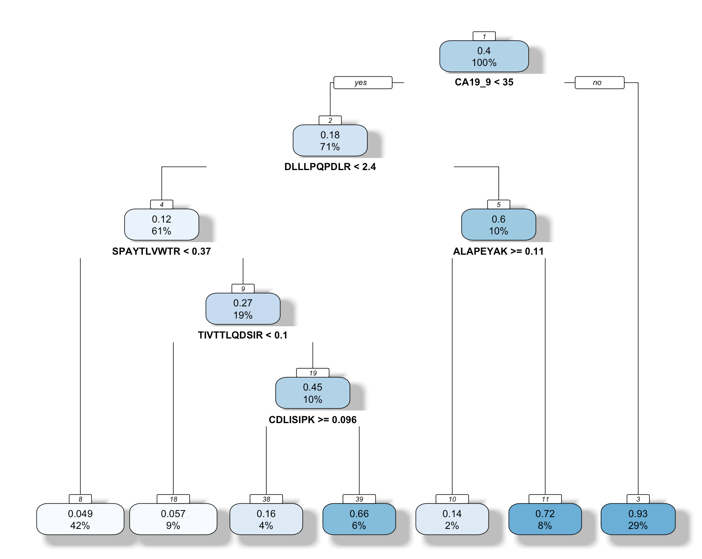
MRM DL 분석
03. Results Compared to Oncotarget
GUIDE: univariate split tree model
Notes:
심리학에서 나온 자극-반응의 이론을 토대로,

Slide 28
MRM DL 분석
04. Results for markers selected by LR
5 | CA19_9 + MBL2 + IGFBP2 + HSPG2 + THBS1 | LR | TRUE | 0.933 | 0.931 | 0.948 | 0.916 | 0.931 | 0.848
 |  | SVM |  | 0.950 | 0.877 | 0.905 | 0.880 | 0.866 | 0.823
 |  | RF |  | 1.000 | 0.936 | 0.957 | 0.929 | 0.938 | 0.881
 |  | DNN |  | 0.986 | 0.931 | 0.930 | 0.902 | 0.945 | 0.889
 |  | MARS |  | 0.949 | 0.729 | 0.951 | 0.918 | 0.919 | 0.861
 |  | GAM |  | 0.959 | 0.929 | 0.944 | 0.909 | 0.926 | 0.853
 | CA19_9 + IFRD1 + IGFBP2 + HSPG2 + THBS1 | LR | TRUE | 0.933 | 0.931 | 0.941 | 0.911 | 0.934 | 0.831
 |  | SVM |  | 0.954 | 0.885 | 0.949 | 0.914 | 0.943 | 0.906
 |  | RF |  | 1.000 | 0.943 | 0.968 | 0.939 | 0.958 | 0.909
 |  | DNN |  | 0.990 | 0.940 | 0.928 | 0.941 | 0.953 | 0.890
 |  | MARS |  | 0.951 | 0.756 | 0.946 | 0.910 | 0.910 | 0.847
 |  | GAM |  | 0.957 | 0.936 | 0.946 | 0.896 | 0.910 | 0.847
6 | CA19_9 + MBL2 + IGFBP2 + HSPG2 + THBS1 + ICAM1 | LR | TRUE | 0.933 | 0.931 | 0.945 | 0.921 | 0.932 | 0.843
 |  | SVM |  | 0.938 | 0.883 | 0.921 | 0.893 | 0.889 | 0.849
 |  | RF |  | 1.000 | 0.939 | 0.954 | 0.930 | 0.926 | 0.876
 |  | DNN |  | 0.991 | 0.942 | 0.941 | 0.923 | 0.947 | 0.841
 |  | MARS |  | 0.949 | 0.719 | 0.951 | 0.918 | 0.919 | 0.861
 |  | GAM |  | 0.960 | 0.932 | 0.956 | 0.925 | 0.936 | 0.875
Notes:
심리학에서 나온 자극-반응의 이론을 토대로,

Slide 29
MRM DL 분석
04. Results for markers selected by LR
Notes:
심리학에서 나온 자극-반응의 이론을 토대로,

Slide 30
MRM DL 분석
03. Results Compared to Oncotarget
Future Works:
DNN으로 뽑힌 마커 조합의 전체 plot 결과
모델 선정 기준: test1, test2, test3, test4의 결과를 weighted average?
Split 의존성 파악 및 제거
Notes:
심리학에서 나온 자극-반응의 이론을 토대로,

